Slide 1
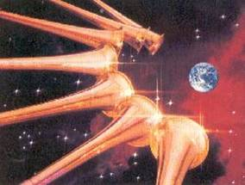
Trumpets of Triumph
Revelation 8–9
Dr. Rick Griffith, Crossroads International Church Singapore
cicfamily.com & BibleStudyDownloads.org

Slide 2
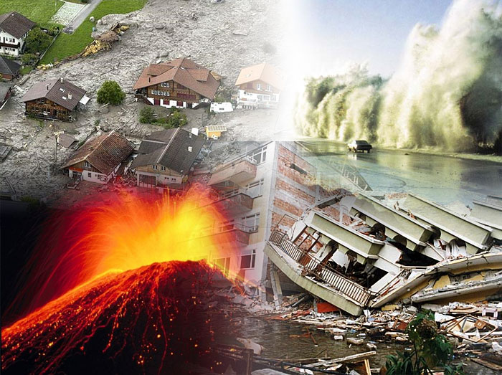
We live in perilous times with many so-called "natural" disasters.

Slide 3
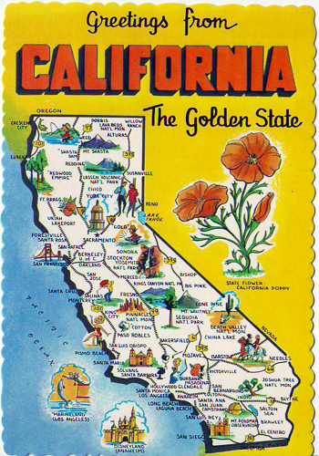
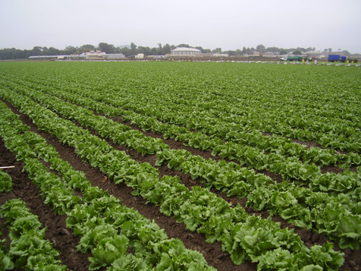
California Agriculture

Slide 4
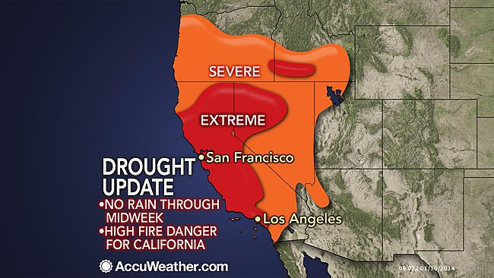
California Drought
21 Jan 2014

Slide 5
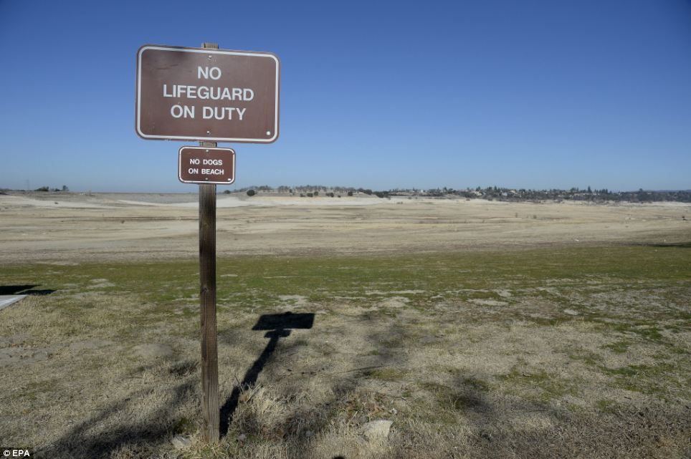
California Drought

Slide 6
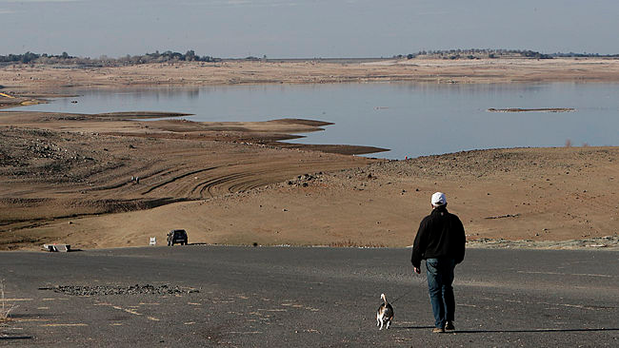
California Drought
9 Jan 2014
Notes:
In this Jan. 9, 2014, file photo, a visitor to Folsom Lake, Calif., walks his dog down a boat ramp that is now several hundred yards away from the waters' edge. (AP Photo/Rich Pedroncelli, File)
http://www.accuweather.com/en/weather-news/los-angeles-drought-situation/21939154 accessed 23 Feb 2014 when still no rain

Slide 7
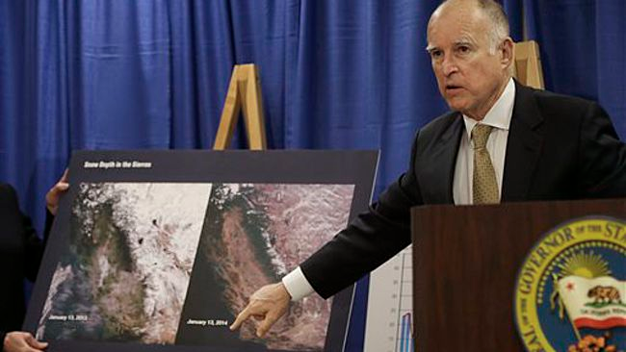
California Drought
13 Jan 2014
Notes:
California Gov. Jerry Brown points to images showing the snow depth in the Sierra mountains on Jan. 13, 2013, left, and Jan. 13, 2014, center, while declaring a drought state of emergency in San Francisco, Friday, Jan. 17, 2014. With a record-dry year, reservoir levels under strain and no rain in the forecast, California Gov. Jerry Brown formally proclaimed the state in a drought Friday, confirming what many already knew. Brown made the announcement in San Francisco amid increasing pressure in recent weeks from the state's lawmakers, including Democratic Sen. Dianne Feinstein. (AP Photo/Jeff Chiu)
http://www.accuweather.com/en/weather-news/los-angeles-drought-situation/21939154 accessed 23 Feb 2014 when still no rain

Slide 8
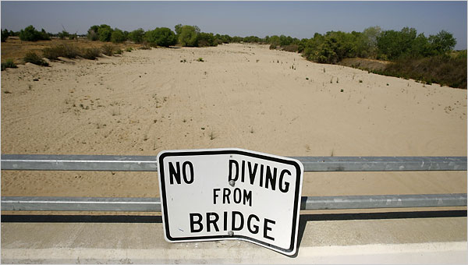
California Drought

Slide 9
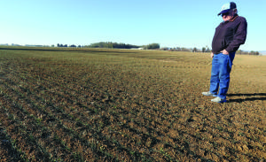
California Crops:
% of the world's production
        80% almonds
        86% lemons
        25% oranges
        90% avocados
        88% strawberries
        84% peaches
        97% plums
        99% artichokes
        67% carrots
        50% bell peppers
        94% broccoli

Slide 10
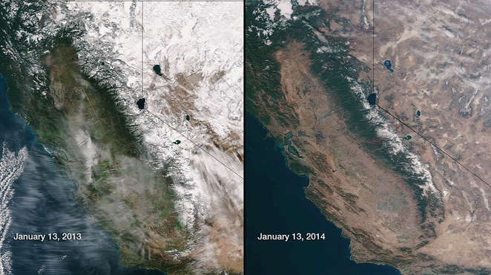
California Ice Pack
13 Jan 2013 vs. 13 Jan 2014
Notes:
http://www.treehugger.com/renewable-energy/thermal-power-plants-use-4x-more-water-us-residents-solar-doesnt-need-drop.html accessed 23 Feb 2014 when still no rain

Slide 11
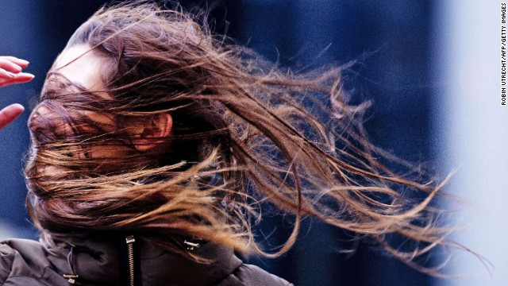
Storms & Floods

Slide 12
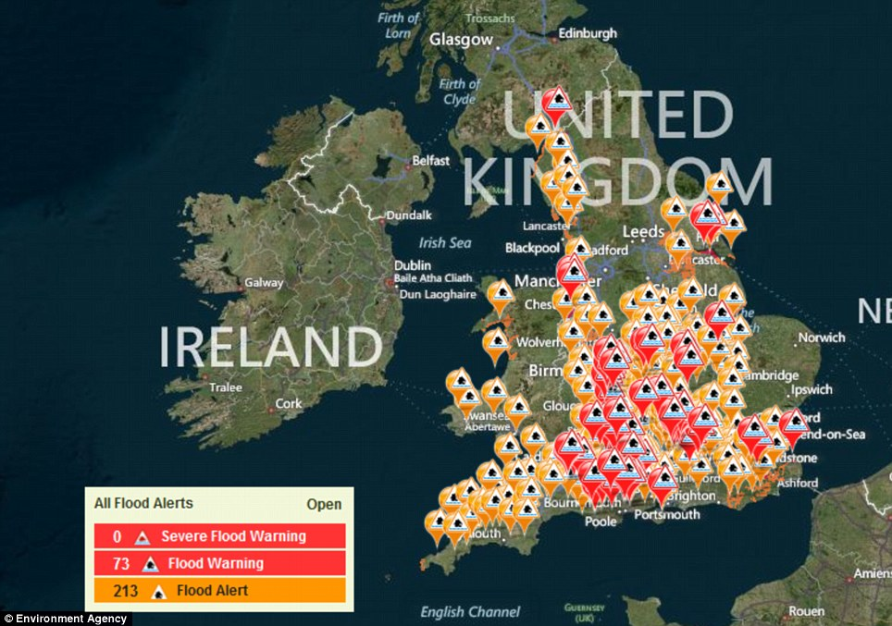
UK Storms & Floods

Slide 13
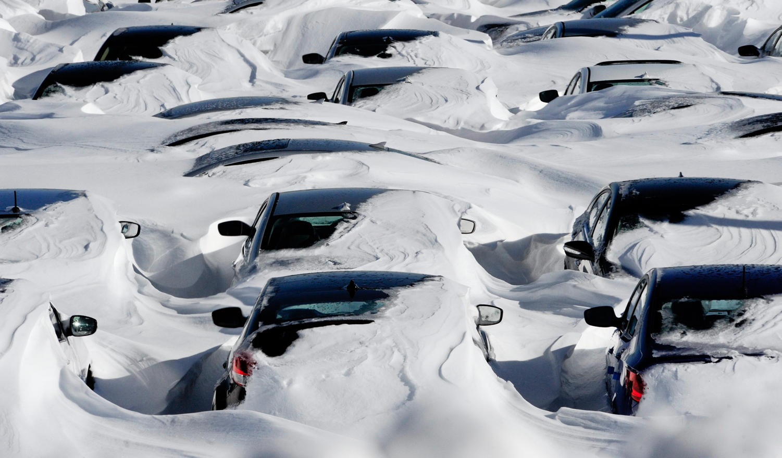
UK Snow

Slide 14
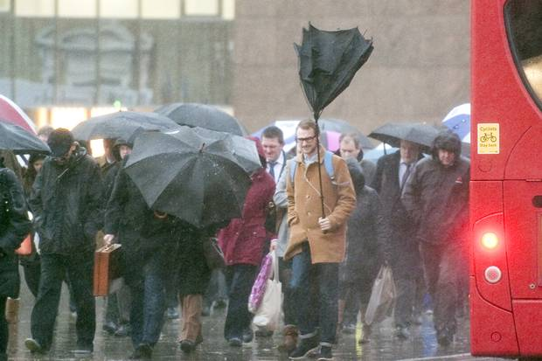
UK Storms & Floods

Slide 15
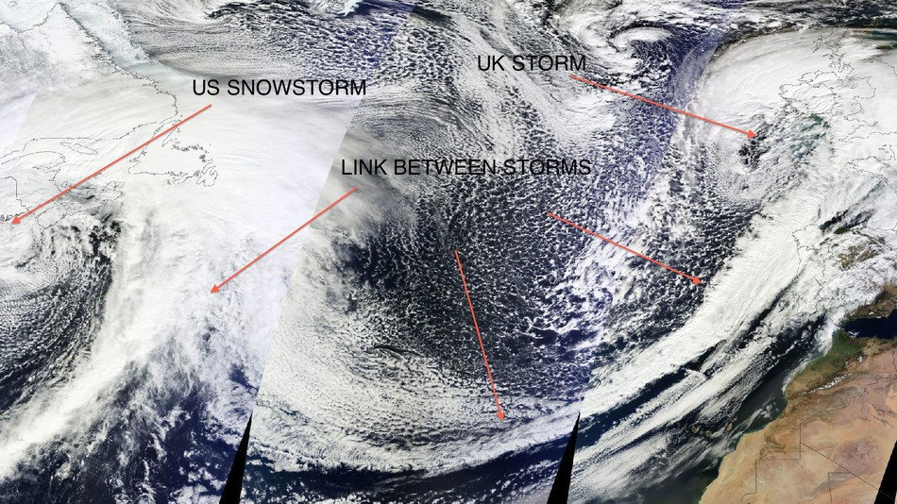
USA Storms & Floods

Slide 16
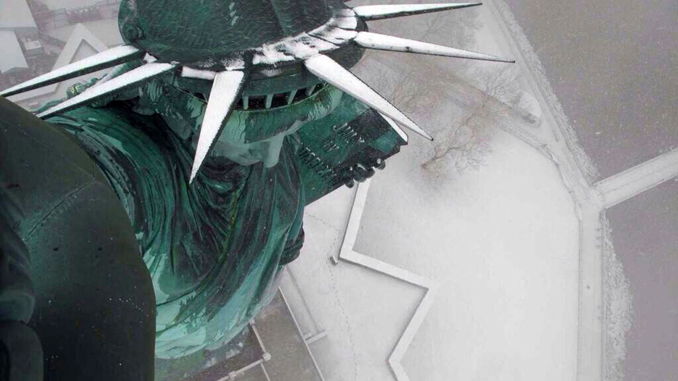
USA Snow

Slide 17
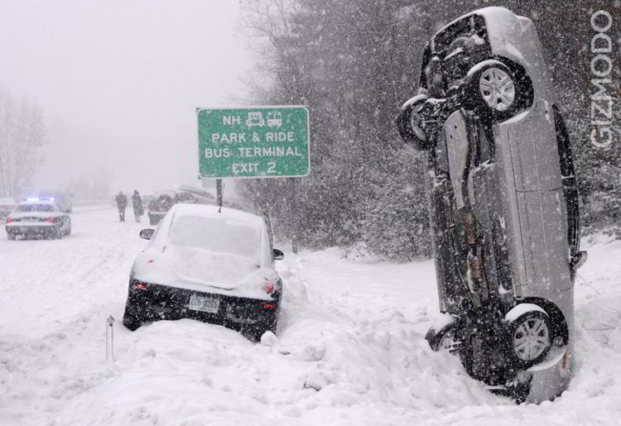
USA Storms & Floods

Slide 18
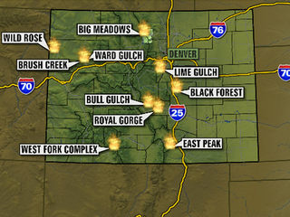
Colorado Fires

Slide 19
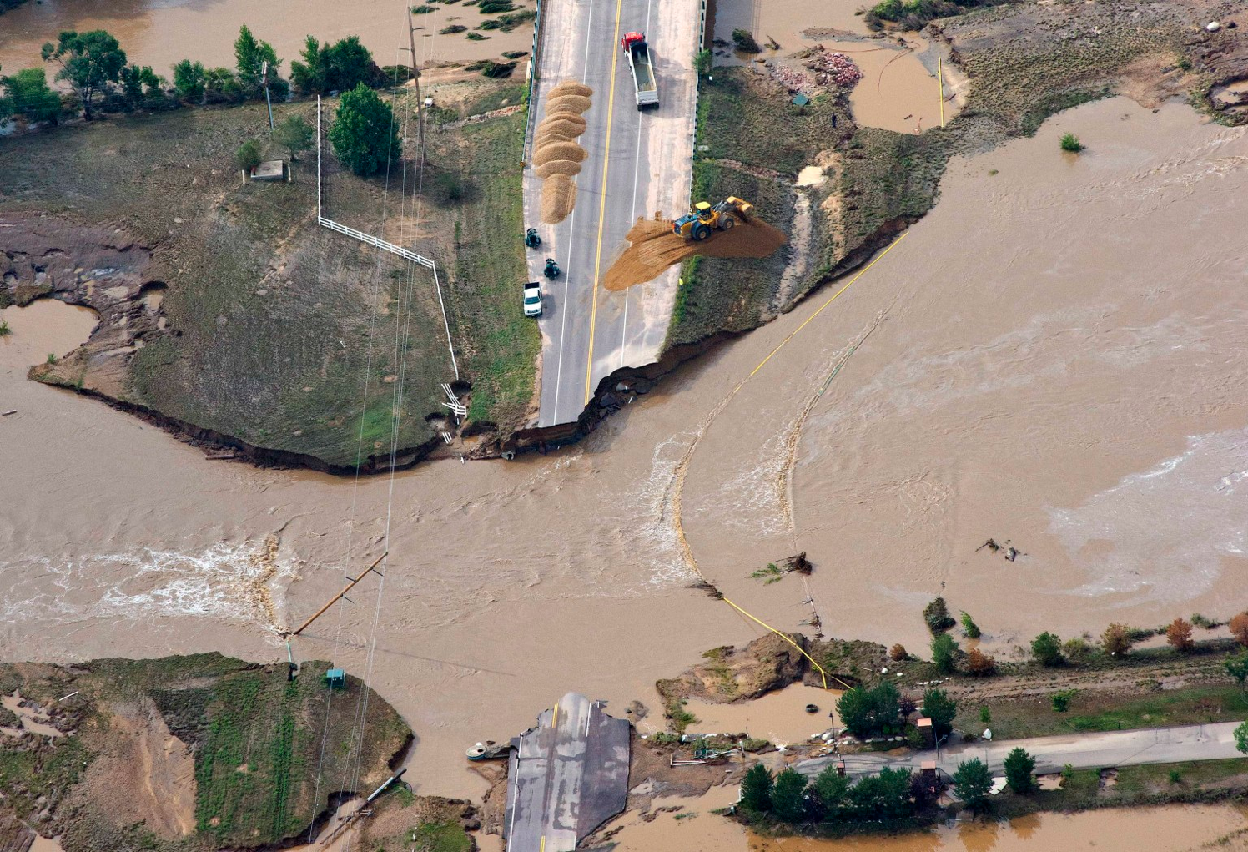
Colorado Floods

Slide 20
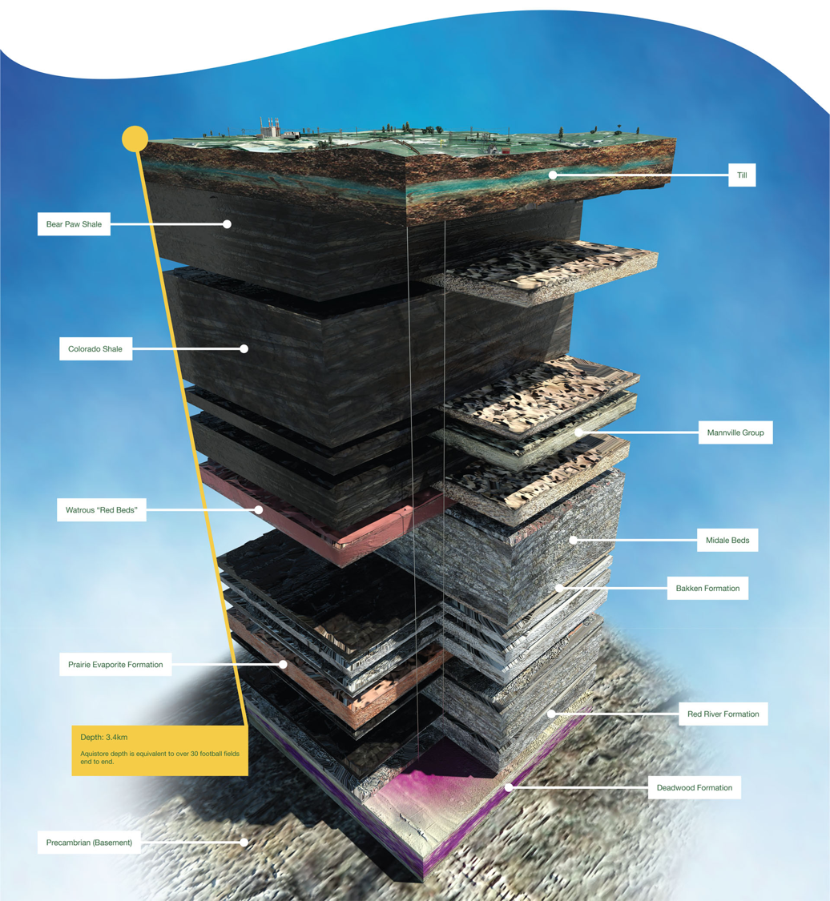
Geology

Slide 21
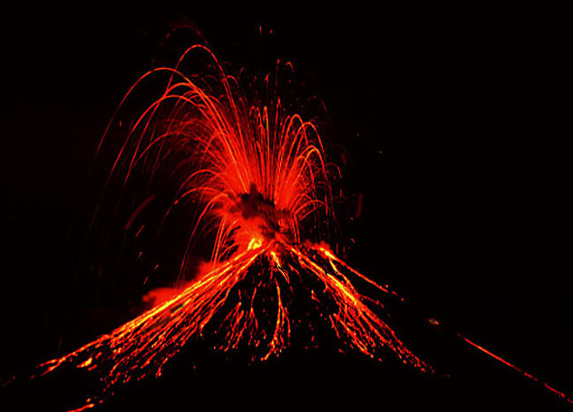
Volcanoes
1990:
55
2013:
83

Slide 22
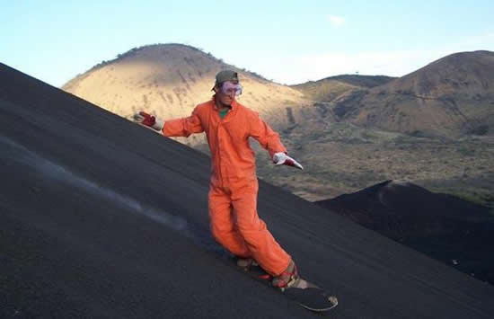
Lavaboarding, anyone?

Slide 23
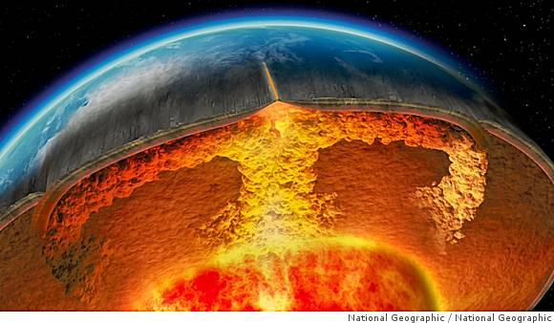
Earth's core is as much as 1,000 degrees hotter than in previous experiments run only 20 years ago

Slide 24
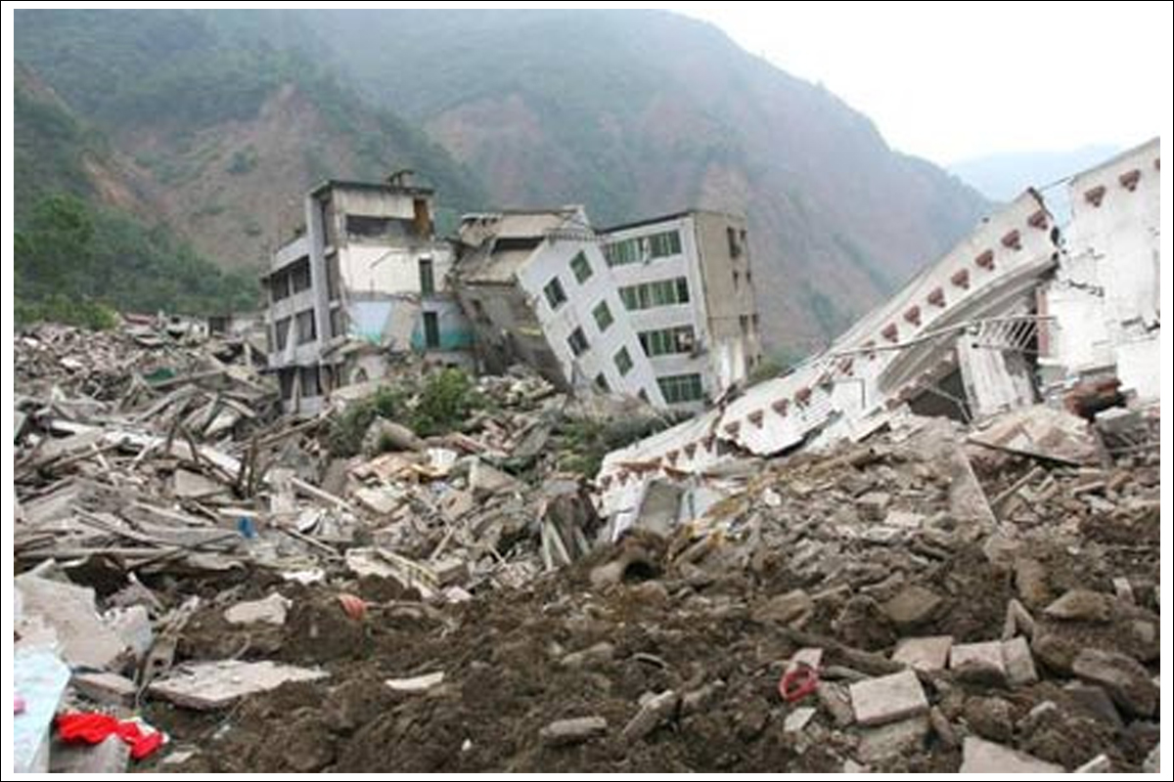
Earthquakes

Slide 25
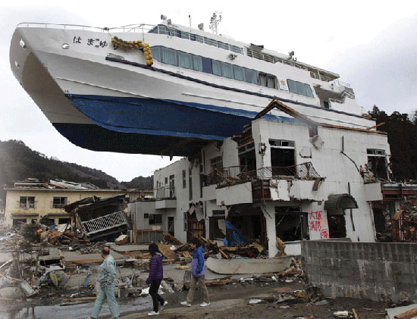
Earthquakes cause Tsunamis

Slide 26
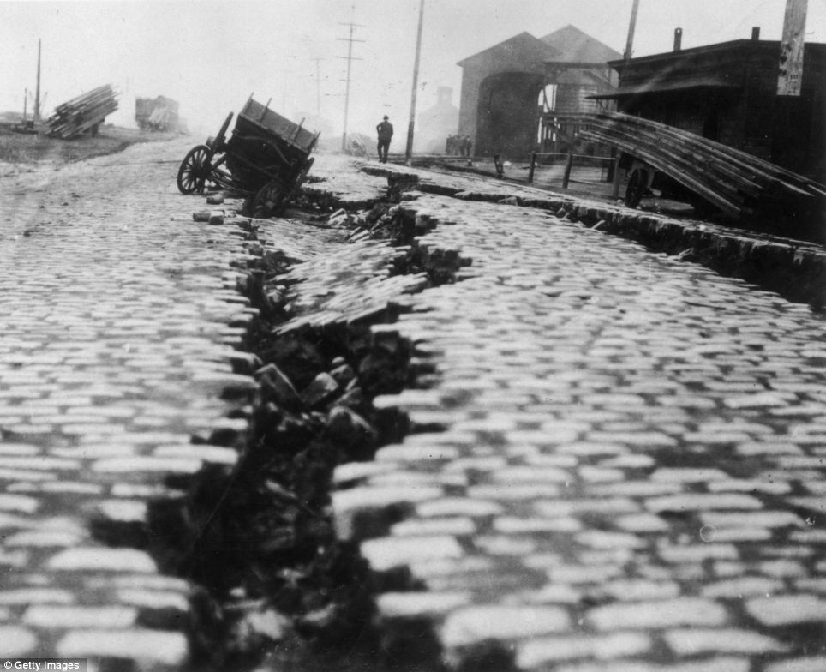
Earthquakes
DATES PERIOD NO. ≥7.0
1863-1900 38 yrs 12
1901-1938 38 yrs 53
1939-1976 38 yrs 71
1977-2014 38 yrs 164 (>190)

Slide 27
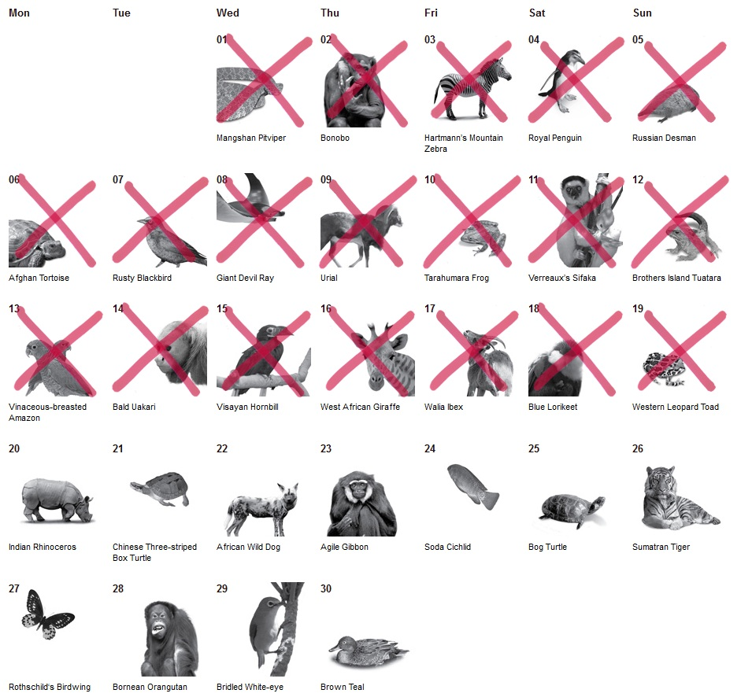
Wildlife Extinction

Slide 28
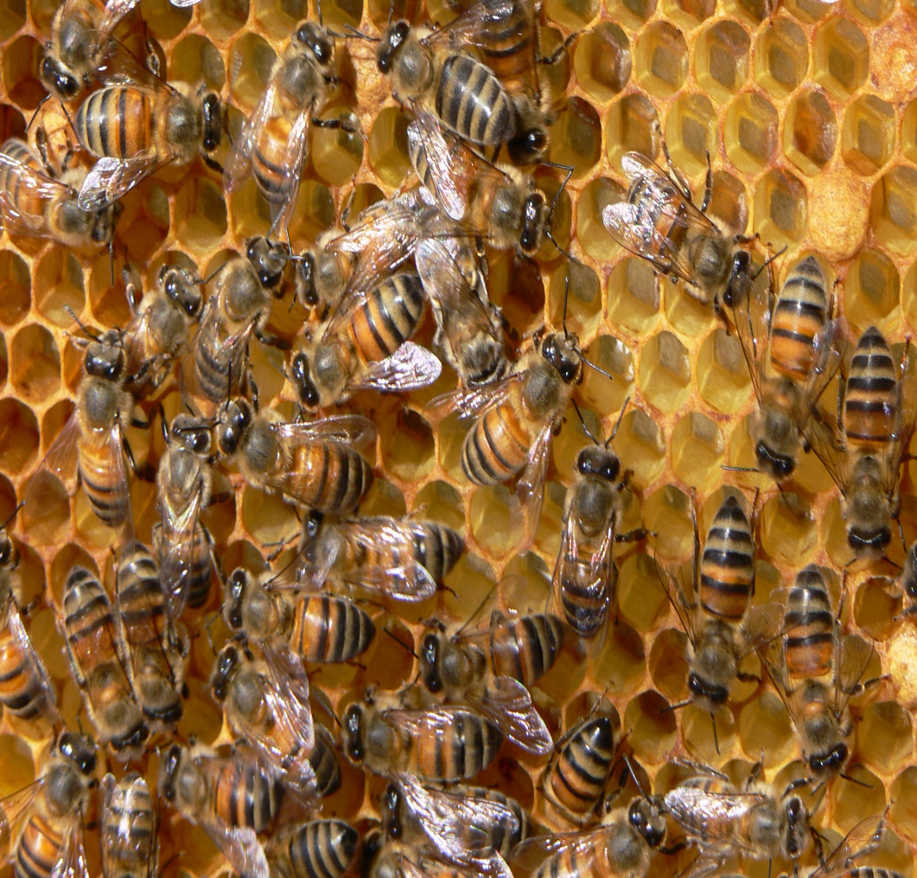
Bees
30-40% of world's bees have died off since 2006!

Slide 29
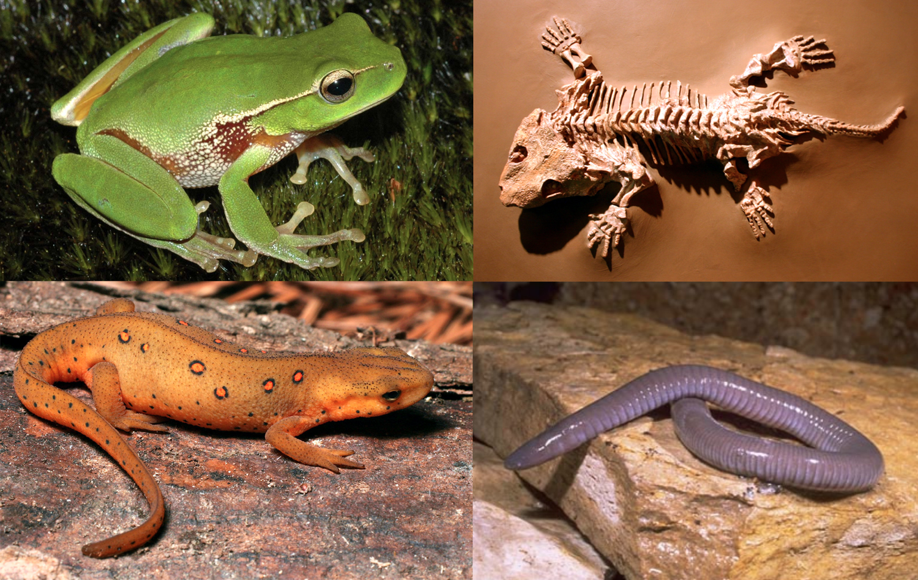
Rapid Decline of Animal Populations
The amphibian rate of extinction seems to be the worst off at 200 times more than the average!

Slide 30
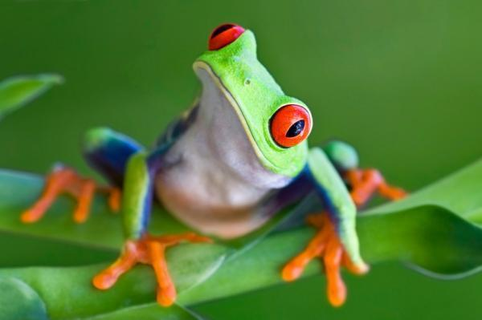
"Why us?"

Slide 31
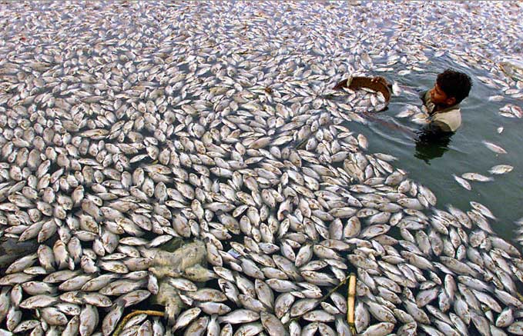
Fish are mysteriously dying
Notes:
10/13/2004: Massive fish death in India - The Cellarcellar.org - 679 × 437 - Search by imageAnd you thought you had a bad job. This guy is collecting dead fish out of Kankaria Lake in Ahmedabad, western India. What happened?
http://cellar.org/showthread.php?t=7000

Slide 32
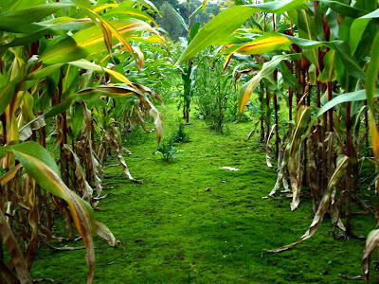
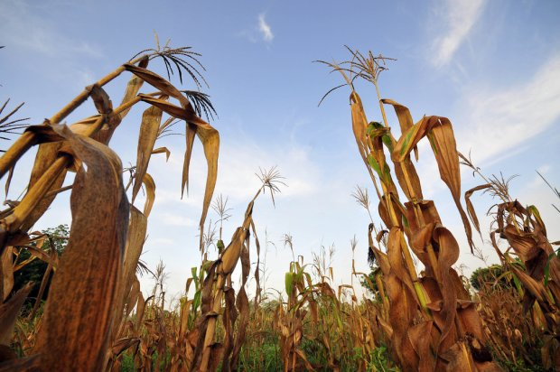
Agricultural Famine

Slide 33
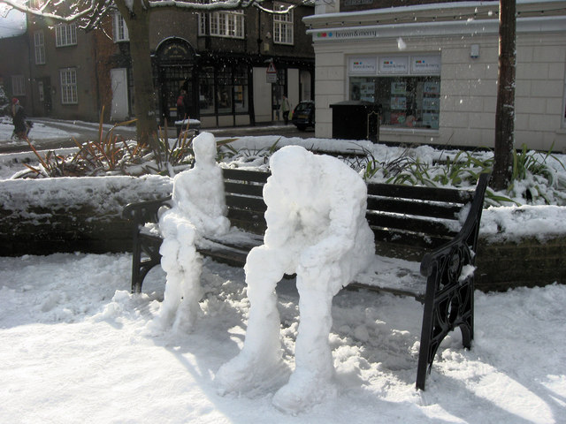
Why so many calamities?

Slide 34
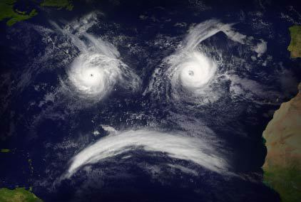
Is God angry?

Slide 35
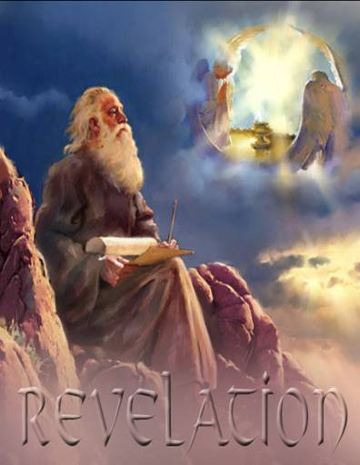
"Unveiling"
381

Slide 36

Revelation
Sovereignty of Christ in Future Victory
Sovereignty in His Person |  |  | Sovereignty over Churches | Sovereignty in End-Time Events
Chapter 1 |  |  | Chapters 2–3 | Chapters 4–22
"What you have seen" (1:19a) |  |  | "What is now" (1:19b) | "What will take place later" (1:19c)
Past |  |  | Present | Future
Christ Unveiled |  |  | Churches Unveiled | Consummation Unveiled
God on Earth |  |  | God's Ambassadors on Earth | Hell on Earth to Heaven on Earth
The Judge |  |  | The Assignments | The Judgments & Rewards
Subject 1:1-3 | Worship of Trinity 1:4-8 | Glorified Christ 1:9-20 | Seven Churches of Asia: Ephesus Smyrna Pergamum Thyatira Sardis Philadelphia Laodicea | Tribulation 4:1–19:10 | Second Coming 19:11-21 | Millennium 20 | Eternal State 21:1–22:5 | Closing: Imminency 22:6-21
AD 95

Slide 37
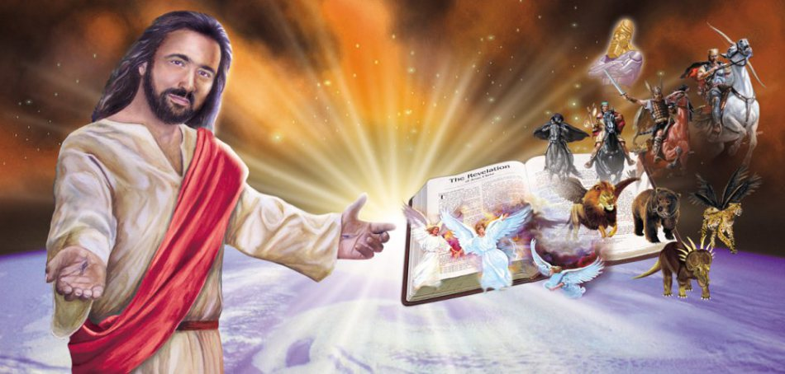
Real Rule Never Changes
367
III. John records future end-time events that demonstrate the sovereignty and final triumph of Jesus Christ as an encouragement to believers struggling with external opposition (Rev. 4–22)

Slide 38

The Tribulation in Prophecy
437
Rapture
2nd Advent
Great
White
Throne
Church Age
Tribulation
Millennium
Battle of
Armageddon
Battle of
Gog and Magog
"How awful that day will be! None will be like it.
It will be a time of Jacob's trouble but he will be saved out of it" (Jer. 30:7)
Notes:
38

Slide 39
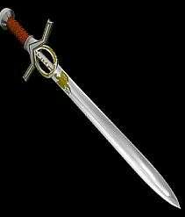
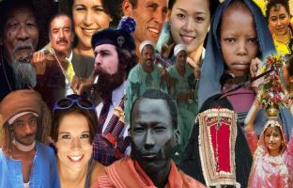
Purposes of the Tribulation
371
To Judge the Nations

Slide 40
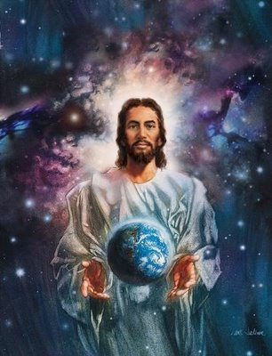
Jesus is the source of all things existing today
371

Slide 41
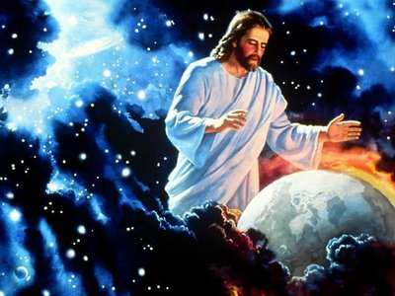
Jesus also sustains his creation
371

Slide 42
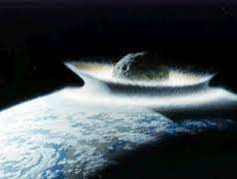
Jesus also will judge the people he has created
374

Slide 43
Purposes of the Tribulation
371
To Judge the Nations
To Discipline Israel
To Save Israel
To Establish the Millennial Kingdom

Slide 44
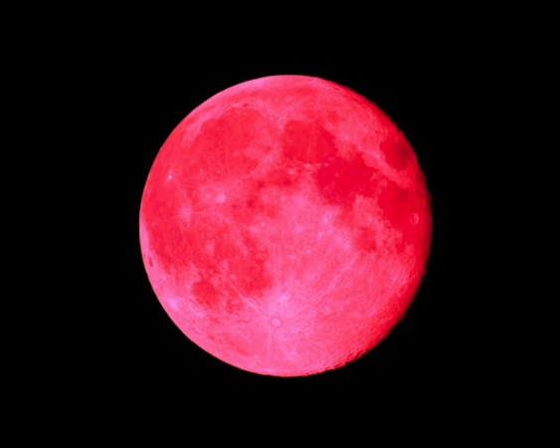
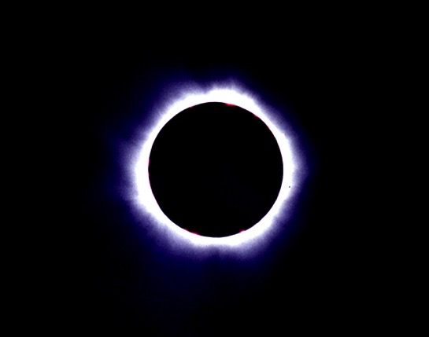
Names for the Tribulation
371
• "Day" or "Day of the LORD"—Isa. 30:23-25; 34:1-8; 35:1-10; Joel 2:28-32; 3:1-21; Zeph. 3:8, 16-20; Zech. 14:1-21)
• "Tribulation"—Deut. 4:30; Matt. 24:9, 21, 29; Rev. 7:14
• "Time of Jacob's trouble"—Jer. 30:7
• "Wrath of God"—Zeph. 1:15; 1 Thess. 1:10; 5:9; Rev. 11:18; 15:1; 16:1
• "Seven"—Dan. 9:27

Slide 45
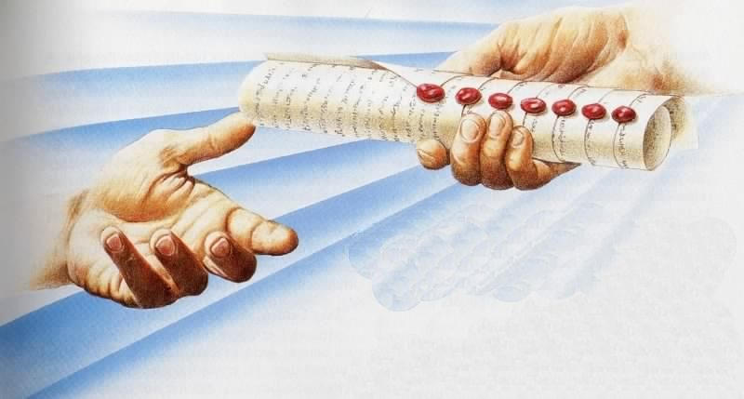
The Seal Judgments
369
The Scroll Sealed with Seven Seals…
is firmly in the right hand of the Father (5:1)!

Slide 46
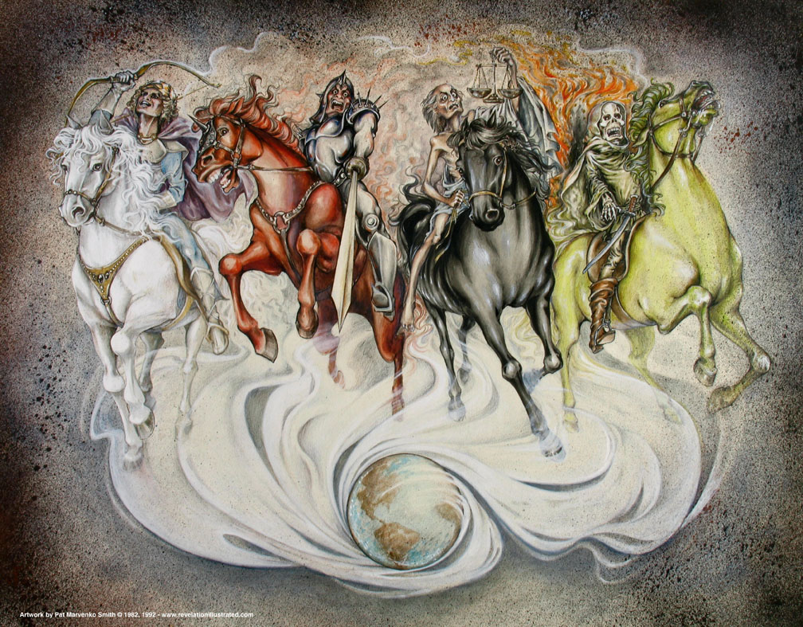
Seals 1-4 in Revelation 6

Slide 47
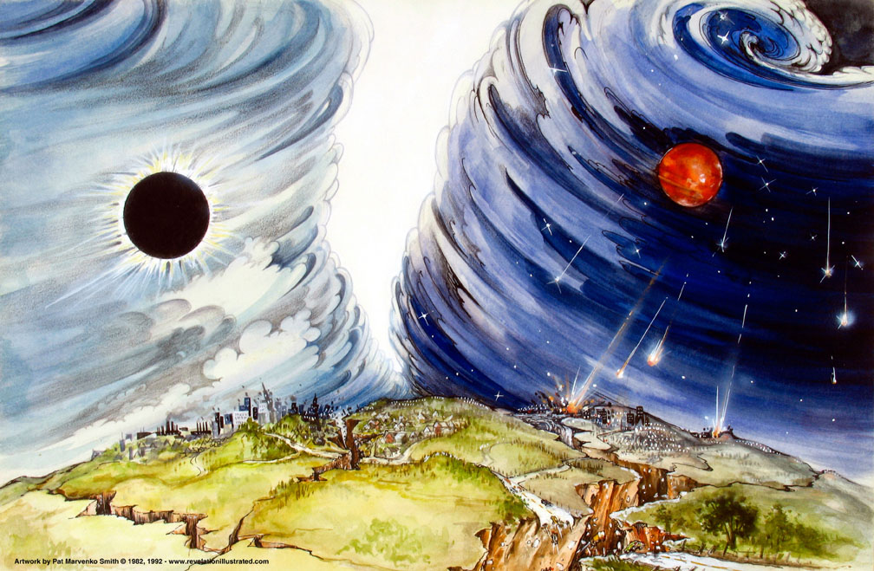
Seal #6
(6:12-17)

Slide 48
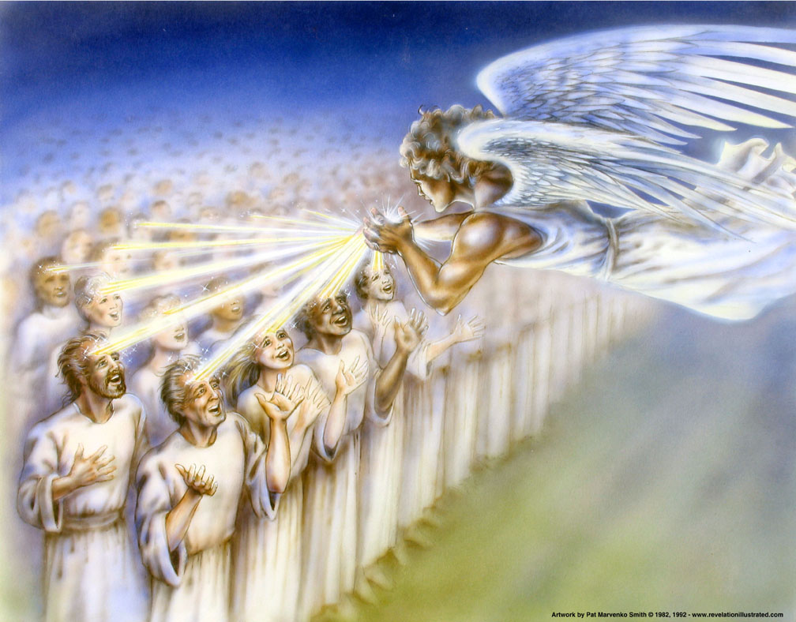
144,000 Sealed (7:3)

Slide 49
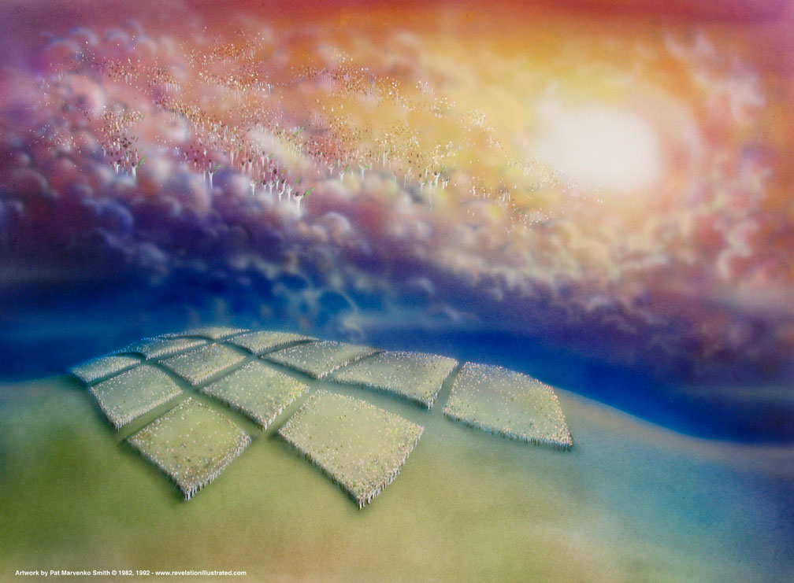
144,000 sealed (7:1-8)
And I heard how many were marked with the seal of God— 144,000 were sealed from all the tribes of Israel:
⁵from Judah 12,000
from Reuben 12,000
from Gad 12,000
⁶from Asher 12,000
from Naphtali 12,000
from Manasseh 12,000
⁷from Simeon 12,000
from Levi 12,000
from Issachar 12,000
⁸from Zebulun 12,000
from Joseph 12,000
from Benjamin 12,000

Slide 50


Christ balances..
his judgment…
with his grace.
Main Idea of Revelation 6–7
Dr. Rick Griffith • Singapore Bible College • biblestudydownloads.com

Slide 51

Why so many calamities?
Revelation 8:1-5
What judgments are ahead?

Slide 52

I. God will answer his people's prayers for vindication (Rev. 8:1-5)

Slide 53


Slide 54

The seventh seal (8:1-2)
"When the Lamb broke the seventh seal on the scroll, there was silence throughout heaven for about half an hour.
²I saw the seven angels who stand before God, and they were given seven trumpets"
(NLT).
Notes:
"During this silence, the seven angels were given trumpets, significant to John, because he was a Jew and understood the place of trumpets in Israel's national life. According to Numbers 10, trumpets had three important uses: they called the people together (Num. 10:1–8); they announced war (Num. 10:9); and they announced special times (Num. 10:10). The trumpet sounded at Mount Sinai when the Law was given (Ex. 19:16–19), and trumpets were blown when the king was anointed and enthroned (1 Kings 1:34, 39). Of course, everyone familiar with the Old Testament would remember the trumpets at the conquest of Jericho (Josh. 6:13–16)" (Wiersbe).

Slide 55

The Incense
(Rev. 8:3-4)
"Then another angel with a gold incense burner came and stood at the altar. And a great amount of incense was given to him to mix with the prayers of God's people as an offering on the gold altar before the throne."
⁴The smoke of the incense, mixed with the prayers of God's holy people, ascended up to God from the altar where the angel had poured them out" (NLT).
Notes:
"On the great Day of Atonement, the high priest would put incense on the coals in the censer and, with the blood of the sacrifice, enter the holy of holies (Lev. 16:11–14)" (Wiersbe).

Slide 56

Casting Coals (Rev. 8:5)
"Then the angel filled the incense burner with fire from the altar and threw it down upon the earth; and thunder crashed, lightning flashed, and there was a terrible earthquake" (NLT).
379
Notes:
"… But in this scene, the angel put the incense on the altar (presented the prayers before God) and then cast the coals from the altar to the earth! The parallel in Ezekiel 10 indicates that this symbolized God's judgment; and the effects described in Revelation 8:5 substantiate this view. A storm is about to begin! (see Rev. 4:5; 11:19; 16:18)" (Wiersbe).

Slide 57

Seal #5: Martyrs Assured under the Altar (6:9-11)
376
Used with permission

Slide 58

God, the righteous judge, must judge sin!

Slide 59
I. God will answer his people's prayers for vindication (Rev. 8:1-5)

Slide 60

II. Seven trumpet blasts will judge unbelievers (8:6–9:21).
Used with permission

Slide 61

Content of the Judgments
337
 | SEALS | TRUMPETS | BOWLS
1 | White: conqueror | Hail & fire: 1/3 vegetation | Sores
2 | Red: war | Fire: 1/3 sea creatures | Sea to blood
3 | Black: famine | Star: 1/3 fresh water | Fresh water to blood
4 | Pale: death | Dark: 1/3 sun, moon, stars | Sun burns men
 |  | (Trumpets 5-7 are woes)
5 | Martyrs reassured | Woe #1: locusts | Beast's kingdom dark
6 | Wrath: earthquake, signs | Woe #2: Euphrates prep | Euphrates dries up
 | (144,000 sealed) | (Trump #7 = mystery)
7 | 1/2 hour silence | Woe #3: victory imminent | Earthquake & hail
H O R S E S
W O E S
Adapted from Robert Gromacki, NT Survey and H. Wayne House, Chronological & Background Charts of the NT, 19
Notes:
Correlation Between Trumpets & Bowls (Wiersbe):
1 The Judgment
2 The earth
3 The sea
4 The rivers
5 The heavens
6 Mankind—torment
7 An army
Angry nations

Slide 62



Judgments of the 70th Week
370
Revelation 8:7
The first angel sounded his trumpet, and there came hail and fire mixed with blood, and it was hurled down upon the earth. A third of the earth was burned up, a third of the trees were burned up, and all the green grass was burned up.
Why Consecutive?
Normal reading of text
1260 days (Rev. 12:6)
Trump 1 begins after Seal 6
Unrepeatable judgments

Slide 63

Trumpet #1 (8:7)
381
"The first angel blew his trumpet, and hail and fire mixed with blood were thrown down on the earth.
One-third of the earth was set on fire, one-third of the trees were burned, and all the green grass was burned" (8:7 NLT).

Slide 64

Trumpet Judgments 2-4
381
#2 Fire: 1/3 sea creatures
#3 Star: 1/3 fresh water
#4 Dark: 1/3 sun, moon, stars

Slide 65

Trumpet Judgment 2
381
#2 Fire: 1/3 sea creatures
"Then the second angel blew his trumpet, and a great mountain of fire was thrown into the sea…"
(8:8a NLT).

Slide 66

Future Calamities

Slide 67

Trumpet Judgment 2
381
#2 Fire: 1/3 sea creatures
"…One-third of the water in the sea became blood, ⁹one-third of all things living in the sea died, and one-third of all the ships on the sea were destroyed" (8:8b-9 NLT).

Slide 68

Trumpet Judgment 3
"Then the third angel blew his trumpet, and a great star fell from the sky, burning like a torch. It fell on one-third of the rivers and on the springs of water. ¹¹The name of the star was Bitterness. It made one-third of the water bitter, and many people died from drinking the bitter water"
(8:10-11 NLT).
#3 Star: 1/3 fresh water

Slide 69

Trumpet Judgment 4
"Then the fourth angel blew his trumpet, and one-third of the sun was struck, and one-third of the moon, and one-third of the stars, and they became dark. And one-third of the day was dark, and also one-third of the night" (8:12 NLT).
#4 Dark: 1/3 sun, moon, stars

Slide 70

Introducing Two Woes/Terrors (8:13)
"Then I looked, and I heard a single eagle crying loudly as it flew through the air, 'Terror, terror, terror to all who belong to this world because of what will happen when the last three angels blow their trumpets'" (NLT).
381

Slide 71


The Great Star
(Trumpet #5 = Woe #1)
381
"Then the fifth angel blew his trumpet, and I saw a star that had fallen to earth from the sky…"
(9:1a NLT).

Slide 72

The Bottomless Pit (Trumpet #5 = Woe #1)
"…and he was given the key to the shaft of the bottomless pit. ²When he opened it, smoke poured out as though from a huge furnace, and the sunlight and air turned dark from the smoke"
(9:1b-2 NLT).
381

Slide 73

Locusts
(Trumpet #5 = Woe #1)
381
"Then locusts came from the smoke and descended on the earth, and they were given power to sting like scorpions" (9:3).

Slide 74

Locusts
(Trumpet #5 = Woe #1)
381
"Then locusts came from the smoke and descended on the earth, and they were given power to sting like scorpions" (9:3).

Slide 75


Locusts
(Trumpet #5 = Woe #1)
381
"They were told not to harm the grass or plants or trees, but only the people who did not have the seal of God on their foreheads"
(9:4 NLT)

Slide 76

Locusts
(Trumpet #5 = Woe #1)
381
"They were told not to kill them but to torture them for five months with pain like the pain of a scorpion sting. ⁶In those days people will seek death but will not find it. They will long to die, but death will flee from them!" (9:5-6 NLT)

Slide 77

Locusts
(Trumpet #5 = Woe #1)
381
"The locusts looked like horses prepared for battle. They had what looked like gold crowns on their heads, and their faces looked like human faces. ⁸They had hair like women's hair and teeth like the teeth of a lion" (9:7-8 NLT).

Slide 78



Literal?
Figurative?
381
"They wore armor made of iron, and their wings roared like an army of chariots rushing into battle. ¹⁰They had tails that stung like scorpions, and for five months they had the power to torment people" (9:9-10 NLT).

Slide 79

Modern Attack Helicopters?
381
"They wore armor made of iron, and their wings roared like an army of chariots rushing into battle. ¹⁰They had tails that stung like scorpions, and for five months they had the power to torment people" (9:9-10 NLT).

Slide 80

The Locust Lord
(Trumpet #5 = Woe #1)
381
"Their king is the angel from the bottomless pit; his name in Hebrew is Abaddon, and in Greek, Apollyon the Destroyer" (9:11 NLT).

Slide 81

Trumpets #5-#6
(9:1-12)
The bad news is I couldn't die when I was bitten 6000 times by the flying scorpions from hell.
The good news is we will most likely die by the next plague.

Slide 82
"The first terror is past, but look, two more terrors are coming!" (9:12 NLT).

Slide 83


Euphrates Angels (Trumpet #6)
382
"I heard the size of their army, which was 200 million mounted troops" (9:16).
"Then the four angels who had been prepared for this hour and day and month and year were turned loose to kill one-third of all the people on earth" (9:15).
"And the voice said to the sixth angel who held the trumpet, 'Release the four angels who are bound at the great Euphrates River'"
(9:14 NLT).
Notes:
83

Slide 84

Supernatural horse-and-rider creatures (Trumpet #6 = Woe #2)
"And in my vision, I saw the horses and the riders sitting on them. The riders wore armor that was fiery red and dark blue and yellow. The horses had heads like lions, and fire and smoke and burning sulfur billowed from their mouths" (9:17 NLT).

Slide 85

Lethal Heads
"One-third of all the people on earth were killed by these three plagues—by the fire and smoke and burning sulfur that came from the mouths of the horses" (9:18 NLT).

Slide 86

Lethal Tails
"Their power was in their mouths and in their tails. For their tails had heads like snakes, with the power to injure people"
(9:19 NLT).

Slide 87
God seeks repentance!
"But the people who did not die in these plagues still refused to repent of their evil deeds and turn to God. They continued to worship demons and idols made of gold, silver, bronze, stone, and wood—idols that can neither see nor hear nor walk!
²¹And they did not repent of their murders or their witchcraft or their sexual immorality or their thefts" (9:20-21 NLT).

Slide 88
Why so many calamities?
Revelation 8:1-5
What judgments are ahead?

Slide 89

Main Idea
The prayers of believers will lead to trumpet judgments!

Slide 90
I. God will answer his people's prayers for vindication (Rev. 8:1-5)

Slide 91
II. Seven trumpet blasts will judge unbelievers (8:6–9:21).
Used with permission

Slide 92

What should we do?
Will you let God be God in the earth as a whole—to answer your prayers?
Will you let God be God in your personal life—to let things get difficult to get your attention?

Slide 94

Jesus Wins!
Series on Revelation

Slide 95


NT Preaching link at BibleStudyDownloads.org
Get this presentation and script for free!
Notes:
NT Preaching (np)

